Slide 1
Ad Performance Insights through Statistical Measures
Team 3
Mahesh
Pavan
Wasim
Sura Lakshmi
Hafila
Notes:
Good evening guys we are team 3 and we will be presenting our findings on ad performance using various statistical measures. Our main objective was to derive meaningful insights into the performance of advertisements across two different platforms.

Slide 2
Outline
About the dataset
Plots
Probability
Distribution analysis
Hypothesis testing
Inference on Population Variances using F test
Inference on Population Variances using Chi-Square test
Notes:
Our presentation unfolds in several layers. We start by examining the dataset that anchors our analysis. Following that, we will show you visual representations and dive into probability analyses to assess ad performance dynamics. We then analyze data distributions, engage in hypothesis testing, and wrap up with advanced statistical tests like the F-test and the Chi-Square test, which help us understand variations and relationships in our data

Slide 3
Introduction
Digital advertising is a critical and evolving area
There are numerous platforms to display your ads
This marketing campaign compares two digital adverting companies Facebook and AdWords
This work helps in identifying the most cost-effective platform for specific campaign goals
Notes:
In the realm of marketing, digital advertising is not just prevalent; it's essential. The landscape is ever-evolving with new technologies that reshape how brands connect with potential customers. Today, we'll focus on two giants in the field: Facebook and Google AdWords. Each platform serves a distinct purpose and reaches different audience segments, making our comparative analysis both challenging and insightful

Slide 4
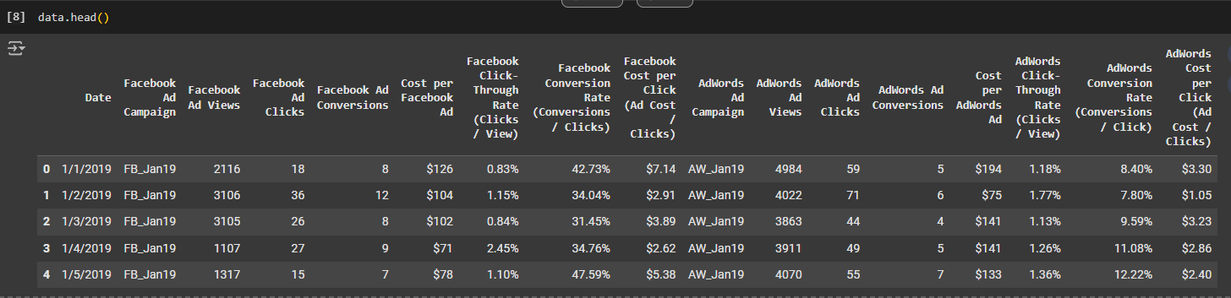
About the dataset
The dataset captures daily performance metrics of Facebook and AdWords ad campaigns over 365 days, making it time-series data.
Notes:
We sourced a detailed dataset that logs daily ad performance metrics across Facebook and AdWords over an entire year. This dataset is rich with variables such as ad views, clicks, conversions, and various cost metrics. Its time-series nature allows us to meticulously track performance trends and evaluate the efficacy of each campaign over consistent periods

Slide 5
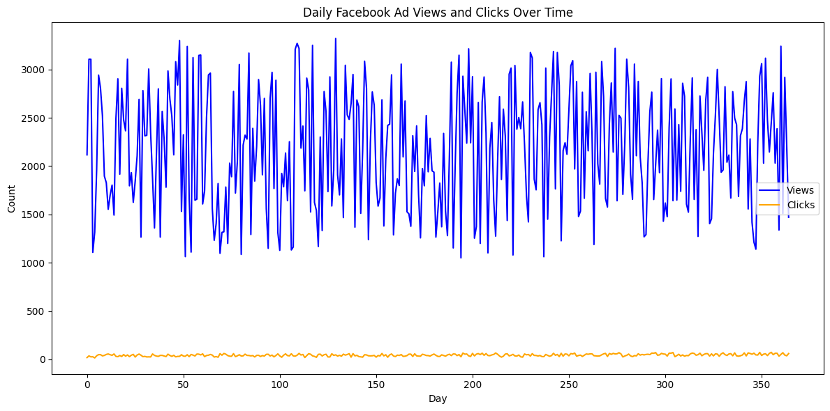
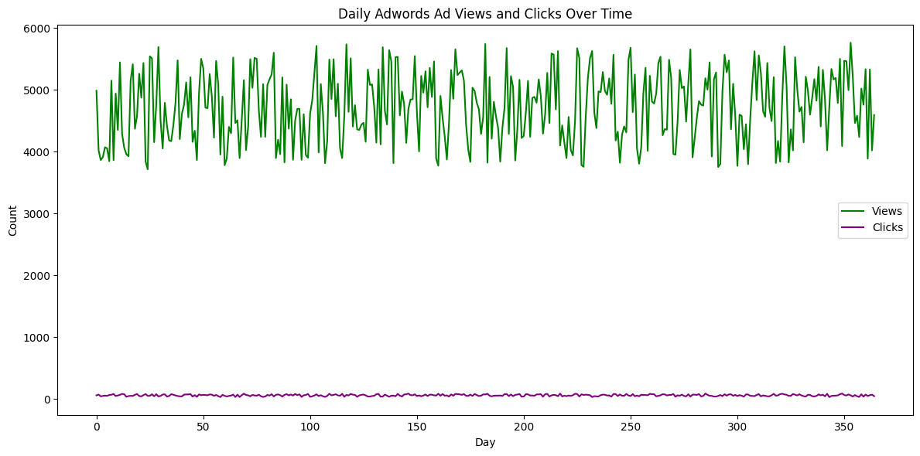
Line Plot (Views and Clicks)
Notes:
This slide presents dual line plots charting daily views and clicks for both platforms throughout the year. Notice the significant fluctuation in Facebook's views, which could be attributed to varying campaign strategies or seasonal trends. Meanwhile, AdWords demonstrates a more stable pattern of high views, suggesting its strong, consistent reach. However, both platforms show relatively low clicks compared to views, indicating areas for potential optimization."

Slide 6
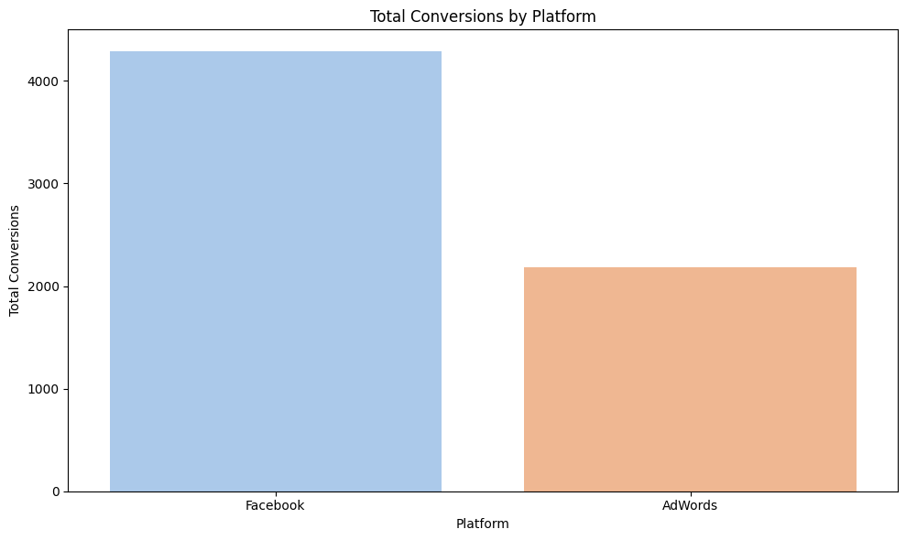
Total Conversions per platform
Notes:
Next, we compare the total conversions achieved by each platform using a straightforward bar chart. While Facebook trails behind AdWords in terms of views, it surprisingly leads with about 4,000 conversions, significantly outperforming AdWords' 2,500. This metric is particularly vital as it highlights the ultimate effectiveness of Facebook’s targeting capabilities, turning fewer views into more actions."

Slide 7
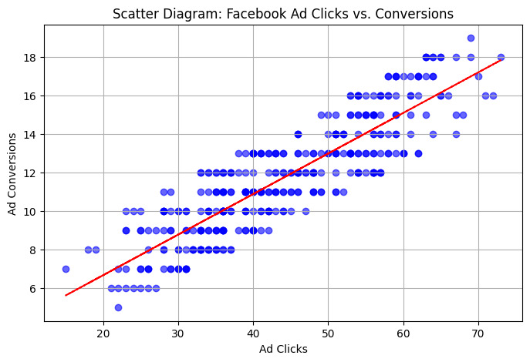
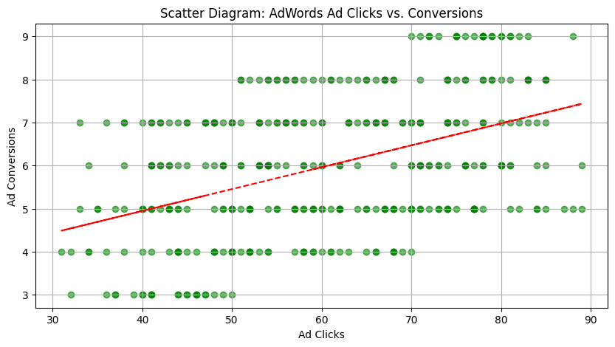
Dot Plot
Notes:
"In this comparative analysis, we employ scatter diagrams to visualize the relationship between ad clicks and conversions for each platform. The AdWords plot shows a consistent, tight clustering along the trend line, suggesting a predictable increase in conversions with more clicks. Conversely, Facebook’s plot, though more scattered, shows a steeper trend line, indicating a higher rate of conversion per click, albeit with more variability."

Slide 8
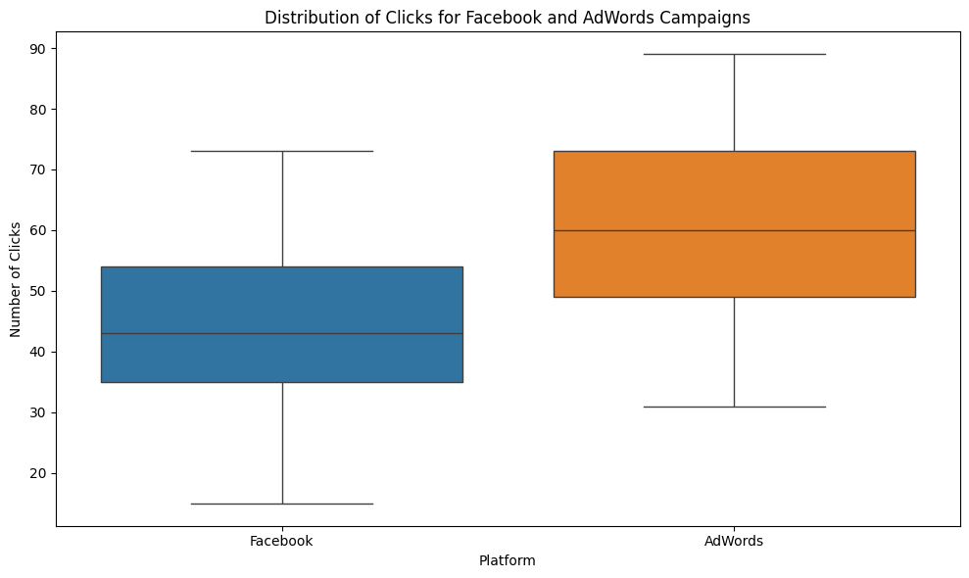
Box Plot
Notes:
Using box plots, we delve into the variability of daily ad clicks on both platforms. Facebook shows a narrower interquartile range, indicating a more consistent click rate day-to-day. In contrast, AdWords displays a wider box and range, suggesting days of high engagement interspersed with quieter periods, which could reflect different advertising strategies or market responses."

Slide 9
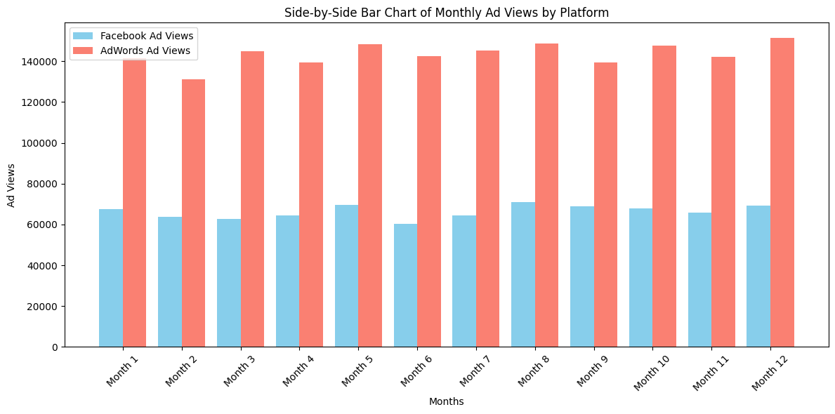
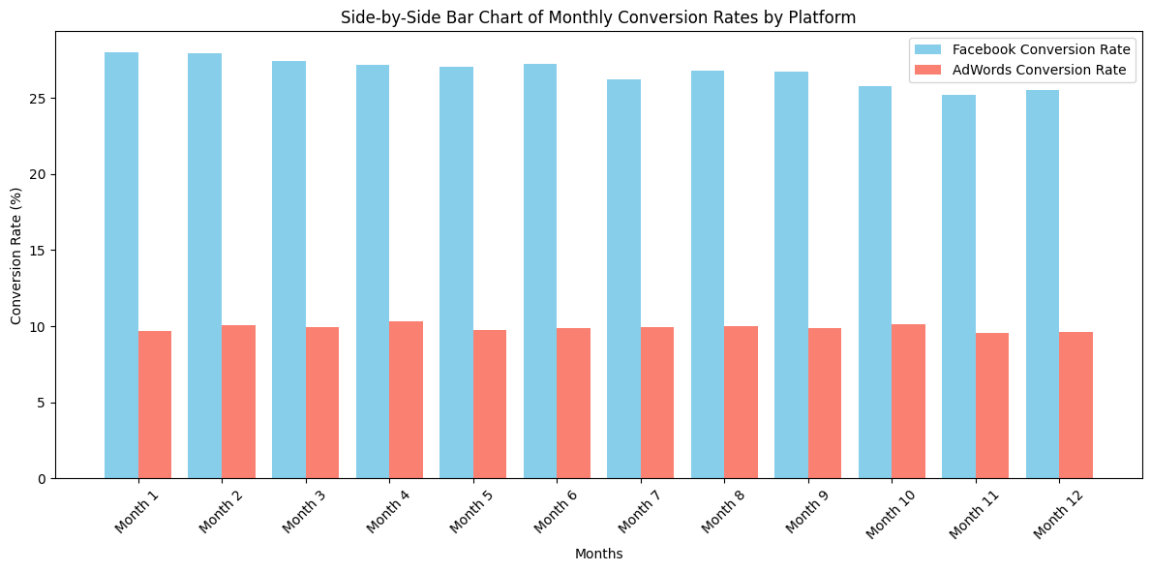
Side by side Bar Chart
Notes:
Here, we illustrate monthly ad views and conversion rates with bar charts for a clearer year-round comparison. AdWords shows higher views every month, highlighting its extensive reach. Yet, the lower chart reveals that Facebook consistently achieves a higher conversion rate, suggesting that its ads, while fewer in views, are more effectively targeted or appealing to the audience."

Slide 10
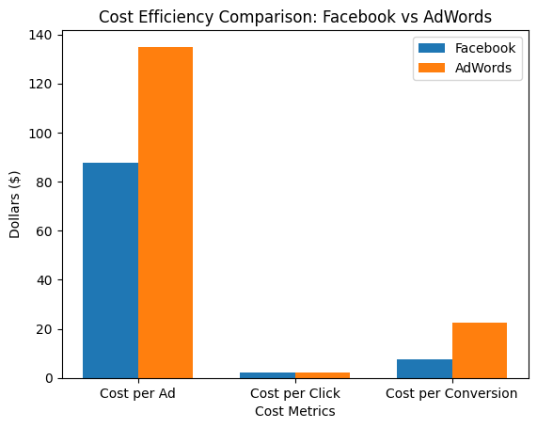
Cost Comparison
Notes:
We assess the economic efficiency of advertising on each platform by comparing cost per ad, cost per click, and cost per conversion. Facebook's lower costs across these metrics suggest it provides more economical advertising options, making it an attractive choice for marketers focused on budget efficiency and high conversion rates."

Slide 11
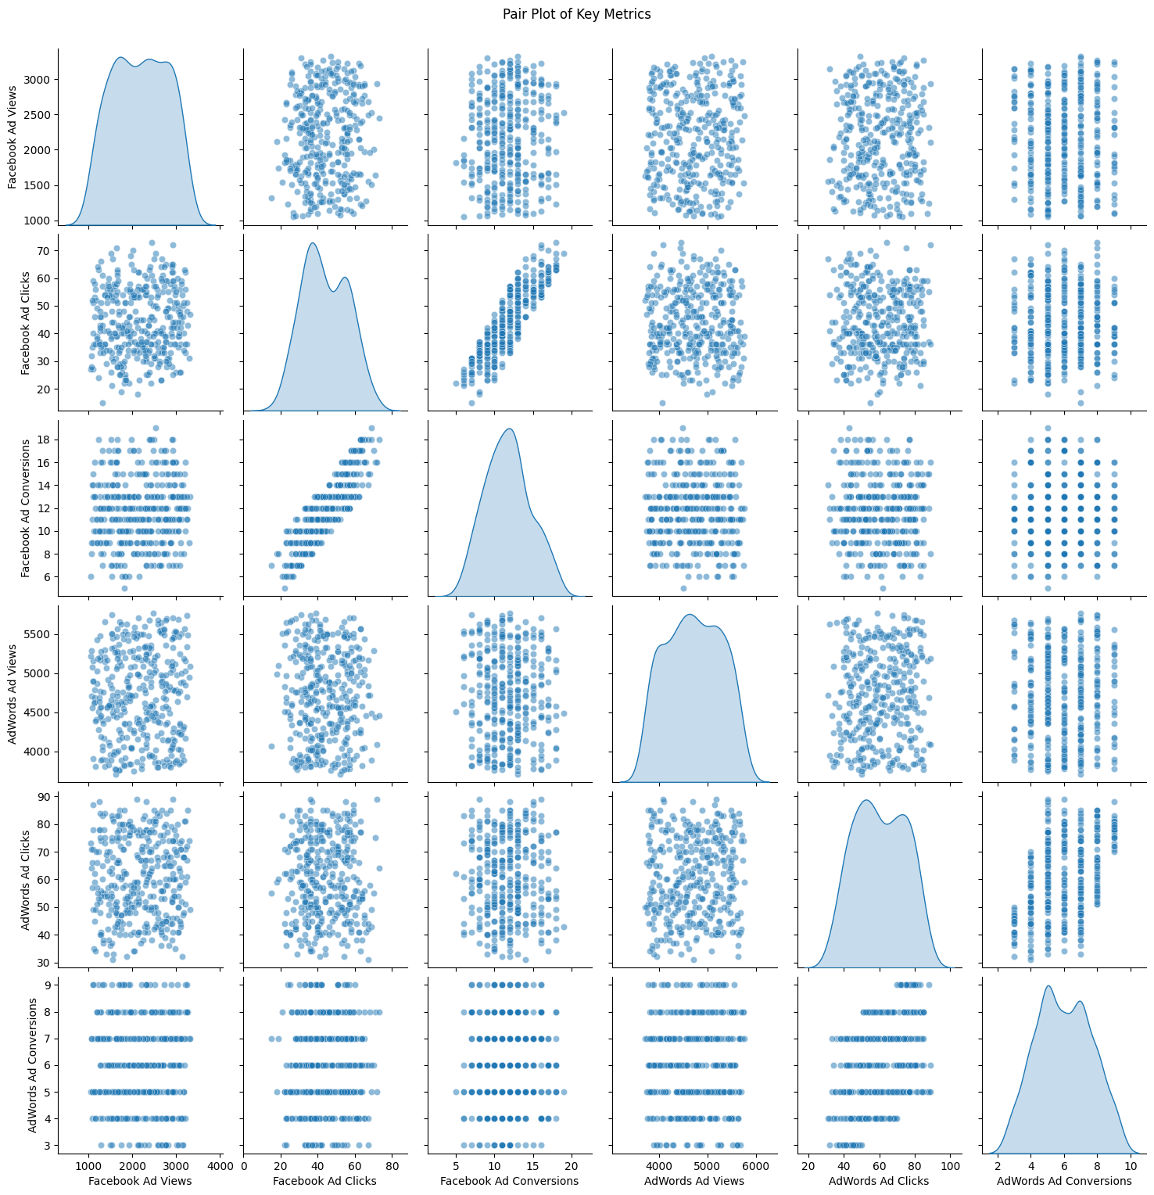
Pair plot for key metrics
Notes:
Our analysis includes a pair plot to explore the relationships and distributions of multiple metrics simultaneously.
The diagonal histograms represent the distribution of each variable. These plots allow us to see how data points are distributed within each metric, helping us identify skewness, bimodality, or other distribution characteristics.
Looking at these plots, we can observe where strong correlations exist. For instance, a strong linear trend between ad views and ad clicks might suggest that more views generally lead to more clicks.
We can also identify any outliers or unusual patterns in the data. This is crucial for diagnosing data issues and for understanding the range of typical behaviors within our campaigns

Slide 12
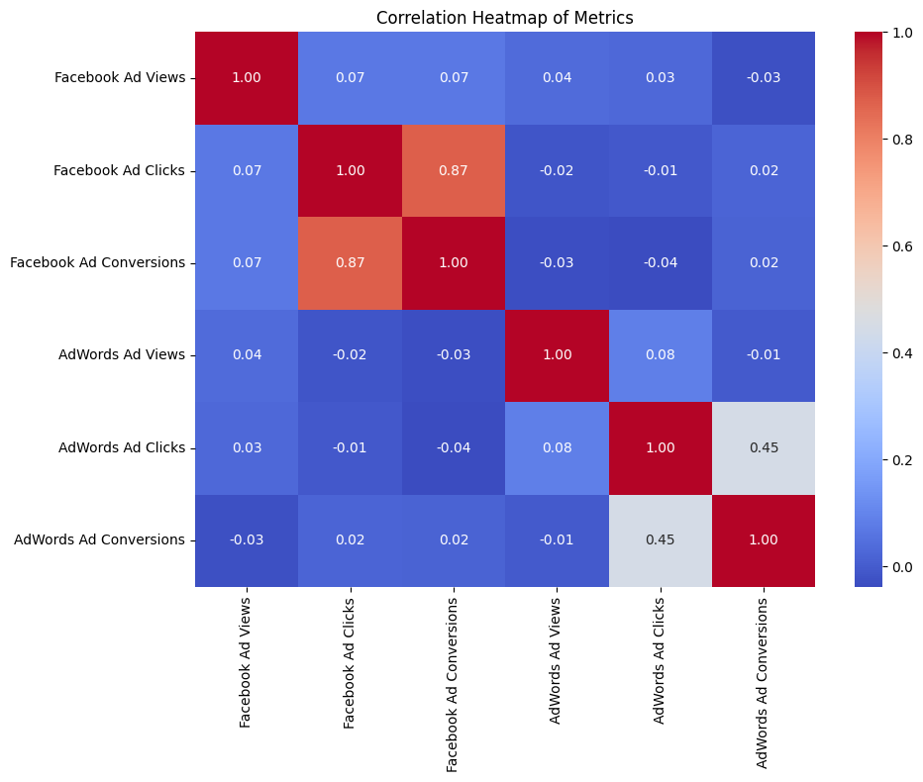
Heat Map
Notes:
This slide displays a correlation heatmap, which is a graphical representation of the correlation coefficients between different advertising metrics for both Facebook and AdWords.
Facebook Ad Clicks and Facebook Ad Conversions have a high positive correlation (0.87), suggesting that clicks on Facebook ads are a strong predictor of conversions."
However, Facebook Ad Views show very little correlation with Clicks and Conversions, indicating that merely viewing an ad on Facebook does not strongly predict whether it will be clicked or lead to a conversion.
AdWords Ad Clicks and AdWords Ad Conversions also show a positive correlation (0.45), though not as strong as Facebook’s, implying that while clicks are somewhat predictive of conversions, other factors may also play a significant role on this platform.
Thank you for your attention. I'll now pass the presentation over to my teammate Pavan, who will discuss the descriptive statistics part of our analysis.

Slide 13
Descriptive Statistics
Central Tendency
More views and clicks on AdWords than Facebook
Higher Conversion on Facebook
Metric | Platform | Mean | Median | Min | Max
Ad Views | Facebook | 2,179.69 | 2,150 | 1,050 | 3,714
 | AdWords | 4,717.20 | 4,690 | 3,714 | 6,063
Ad Clicks | Facebook | 44.05 | 43 | 15 | 73
 | AdWords | 60.38 | 61 | 31 | 89
Ad Conversions | Facebook | 11.74 | 12 | 5 | 20
 | AdWords | 5.98 | 6 | 3 | 11

Slide 14
Descriptive Statistics
Variability
Variability in Views and Conversion is higher in Facebook compared to AdWords.
Metric | Platform | Std Dev | Range
Ad Views | Facebook | 618.07 | 2,664
 | AdWords | 561.11 | 2,349
Ad Clicks | Facebook | 12.14 | 58
 | AdWords | 14.37 | 58
Ad Conversion | Facebook | 2.92 | 15
 | AdWords | 1.63 | 8

Slide 15
Performance Analysis
Categories | Click Probabilities | Conversion Given Click | Source of Conversions
Facebook | 42.18% | 26.66% | 66.25%
AdWords | 57.82% | 9.90% | 33.75%

Slide 16
Performance Analysis
Clicks on Facebook ads lower than AdWords ads
The likelihood of ad Conversion is higher on Facebook (26.66%) than AdWords (9.90%)
66.25% conversion came from Facebook and 33.75% from AdWords.
Higher conversion rate on Facebook is high compared to AdWords

Slide 17
Insights and Recommendations
Campaign Performance
Facebook campaigns demonstrate superior conversion efficiency
AdWords campaigns deliver greater visibility but lower conversion quality
Optimization Opportunities
Analyze factors contributing to variability
Refine targeting and ad creatives to improve CTR and conversion rates
Resource Allocation
Invest more in Facebook campaigns for quality leads and conversions
Use AdWords campaigns to drive traffic and brand visibility while improving interaction efficiency.

Slide 18
Distribution Analysis
Why do we need to know about distribution of data
Assumption of Parametric Tests
Many tests like t-tests and ANOVA assume the data follow a normal distribution; violations may lead to incorrect results.
Accuracy of Results
Normality ensures reliable test statistics, accurate p-values, and well-controlled error rates (Type I & II).
Small Sample Considerations
In small samples, normality is critical as deviations can significantly affect results (unlike larger samples where CLT helps).
Alternative Methods
Non-normal data may require non-parametric tests (e.g., Mann-Whitney U) or data transformation to approximate normality.
Data Interpretation
Normality ensures meaningful interpretation of results, including confidence intervals and effect sizes.

Slide 19
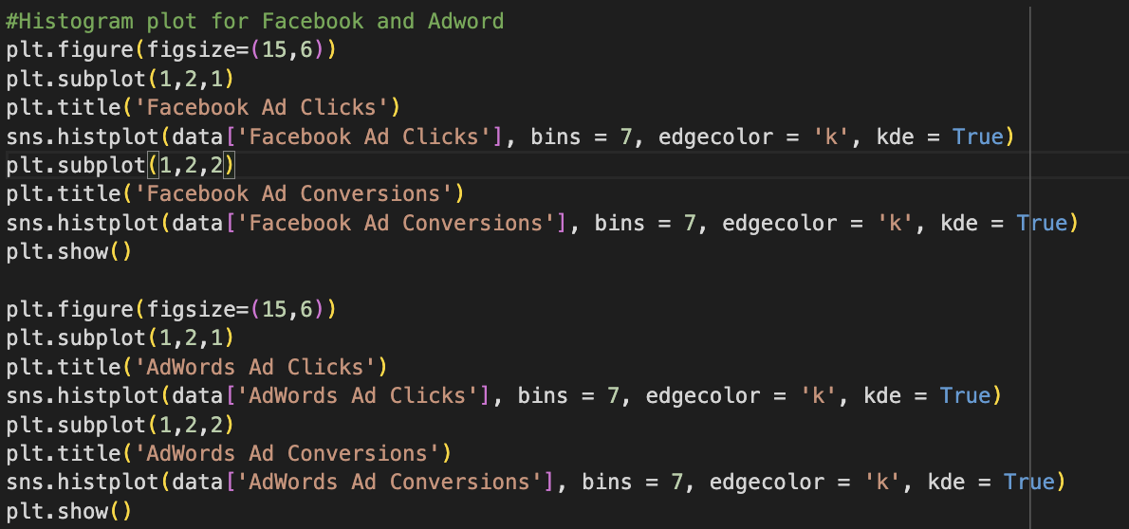
Code for distribution analysis

Slide 20
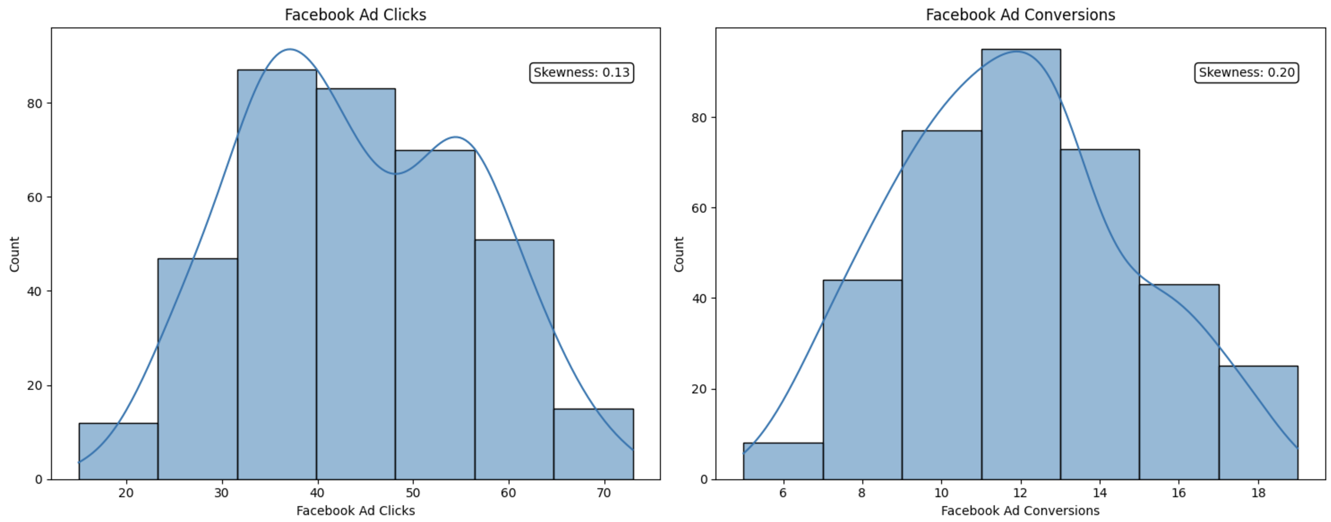
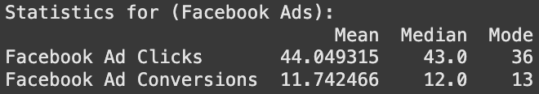
Distribution of Facebook Ad Data

Slide 21
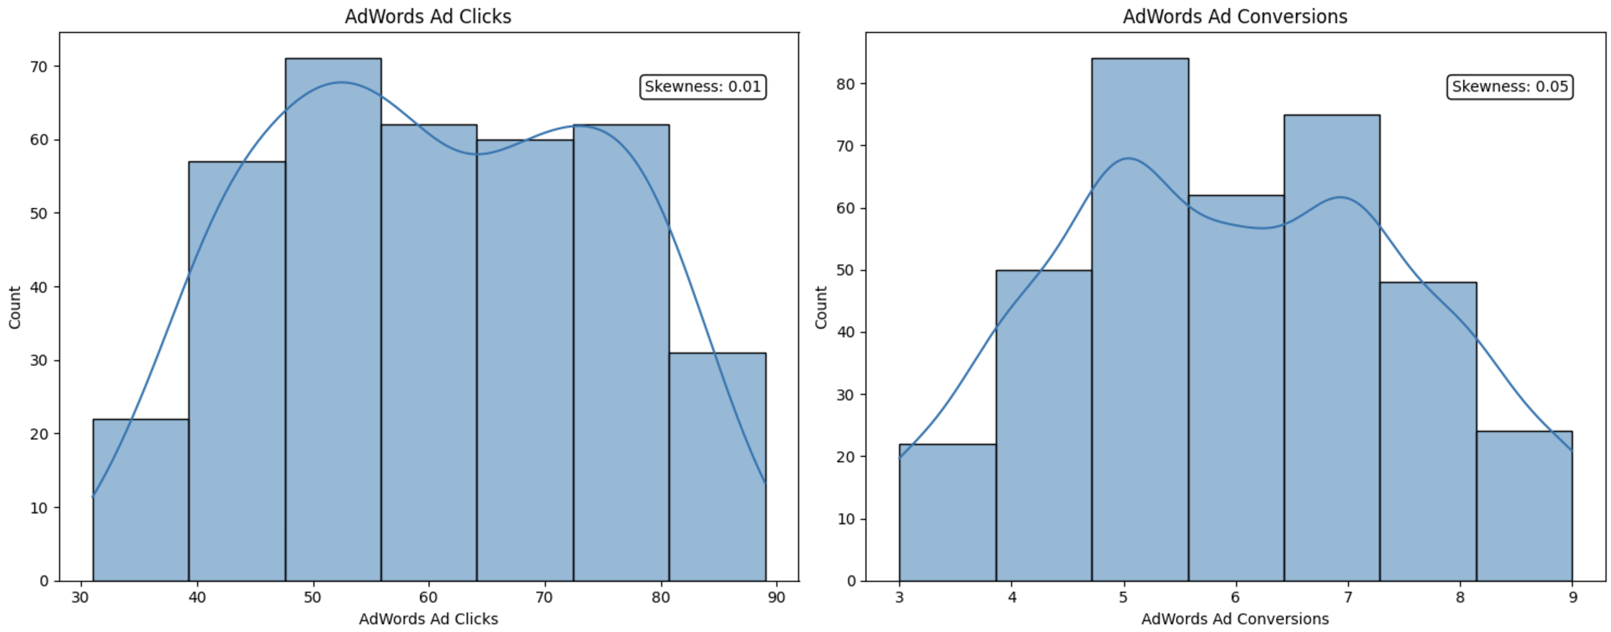
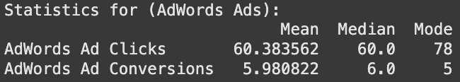
Distribution of AdWords Ad Data

Slide 22
Correlation Analysis between Clicks and Conversions
Why do we do correlation analysis?
Understanding Campaign Effectiveness:
Correlation analysis helps assess if more clicks lead to higher conversions, indicating campaign success.
Optimizing Ad Spend:
It determines if increased clicks translate to conversions, guiding efficient budget allocation for better ROI.
Identifying Platform Performance Differences:
Comparing correlations between platforms helps identify which ad platform converts more effectively.
Improving Targeting Strategies:
A weak correlation can signal issues with targeting or ad content, guiding improvements in segmentation and messaging.
Measuring Campaign Quality:
A high correlation indicates a well-executed campaign, ensuring clicks are leading to meaningful conversions.

Slide 23
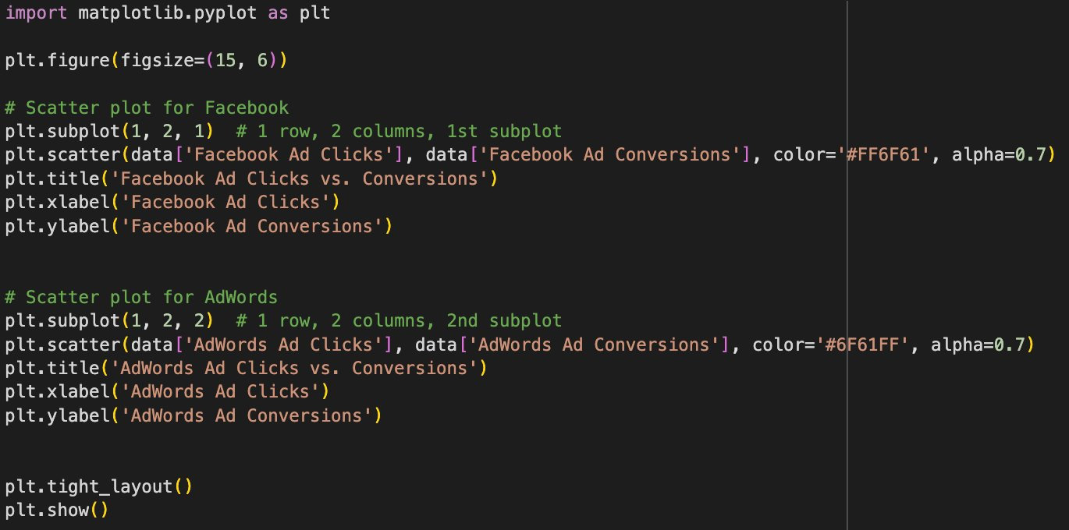
Code for correlation analysis

Slide 24
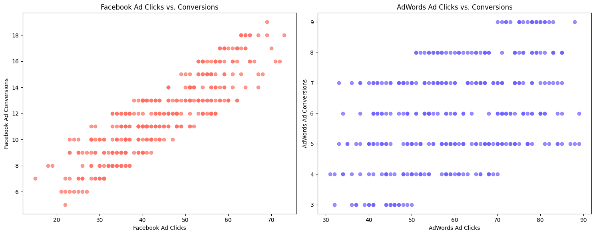
Results

Slide 25
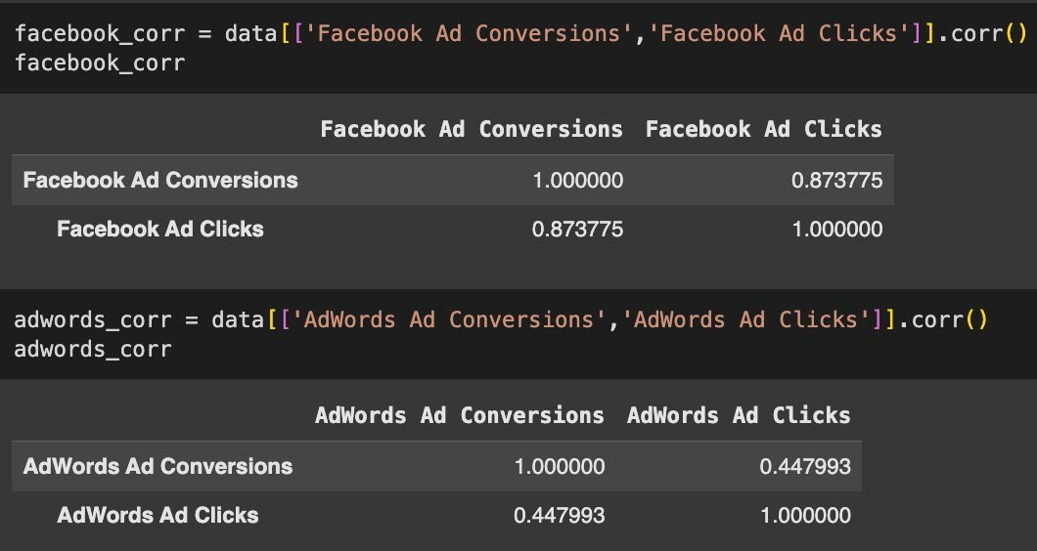
Now we can also quantify the correlation between two using the .corr() function

Slide 26
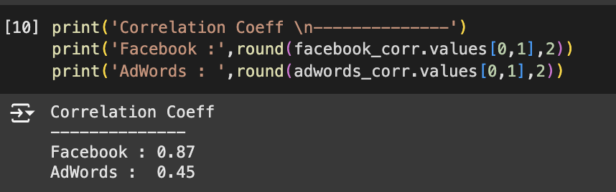
Inference from the result
The correlation coefficient for Facebook (0.87) indicates a strong positive linear relationship, meaning changes in one variable are closely mirrored by the other. For AdWords, the coefficient of 0.45 suggests a moderate positive relationship with a weaker association. This indicates that the variables in Facebook are more strongly related than those in AdWords.
In conclusion, as more people click on Facebook ads, we see a better conversion rate compared to AdWords ads.

Slide 27
Inference about Population Means
While Facebook Ads are generally known to deliver better results compared to AdWords, we aim to statistically assess whether there is a significant difference in the conversion rates between the two platforms.
Objective: Compare the conversion rates of Facebook Ads and AdWords Ads to assess any significant differences.
Approach: Use hypothesis testing to determine if the observed differences are statistically significant.
Procedure:
Calculate the mean conversion rates for both platforms.
Perform a t-test for independent samples to compare the means when standard deviations are unknown.
Perform a z-test for independent samples to compare the means when standard deviations are known.
Hypothesis:
Null Hypothesis (H₀): No significant difference in conversion rates. => H0: µ_Fb = µ_Ad
Alternative Hypothesis (H₁): Significant difference in conversion rates. => H1: µ_Fb ≠ µ_Ad
Goal: Draw insights to optimize ad strategies based on the results of the hypothesis test.

Slide 28
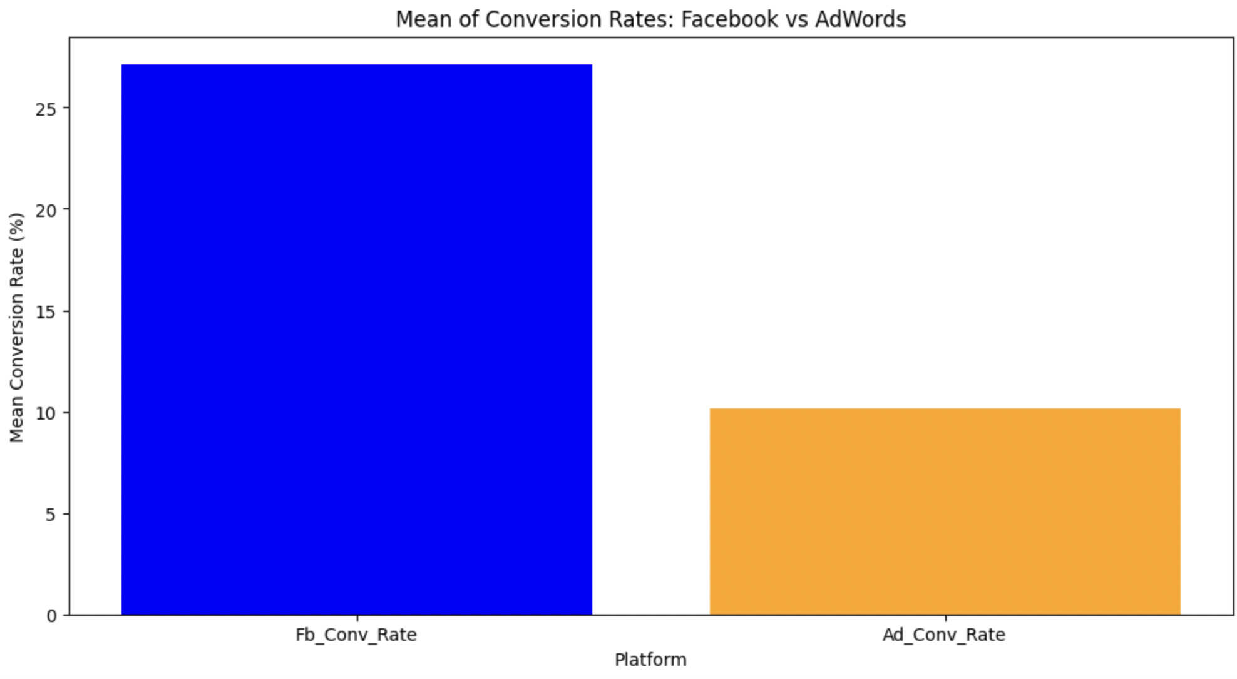
Inference on Population Means
T - test Statistic:
t = (x̄₁ - x̄₂) / √((s₁²/n₁) + (s₂²/n₂))
Z - test Statistic:
z = (x̄₁ - x̄₂) - (μ₁ - μ₂) / √(σ₁²/n₁ +σ₂²/n₂)

Slide 29
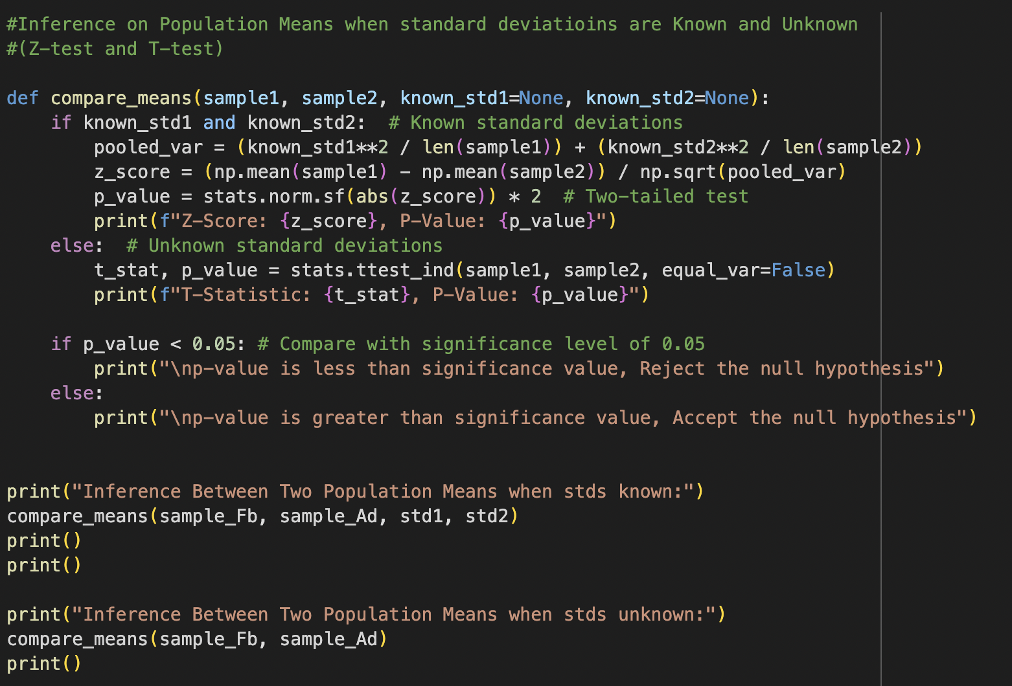
Inference on Population Means using Z- test and T-test
The Z-Test produced a Z-Score of 23.763 and a p-value of 8.006×10−125, while the T-Test yielded a T-Statistic of 23.763 and a p-value of 6.711×10−37.
In both cases, the p-values are far below the significance level
(α=0.05\alpha = 0.05α=0.05),
leading us to reject the null hypothesis.
This result strongly suggests that Facebook and AdWords conversion rates differ significantly.

Slide 30
Inference on Population Variances using F-test
Objective: To test whether the variances of Facebook and AdWords conversion rates are equal.
F-Statistic: Ratio of the variances of the two samples. A value close to 1 suggests equal variances.
F = (s₁²) / (s₂²)
Hypothesis:
Null Hypothesis (H0): The variances of the two populations are equal.
H0: σ_Fb^2 = σ_Ad^2
Alternate Hypothesis (H1): The variances of the two populations are not equal.
H1: σ_Fb^2 ≠ σ_Ad^2

Slide 31
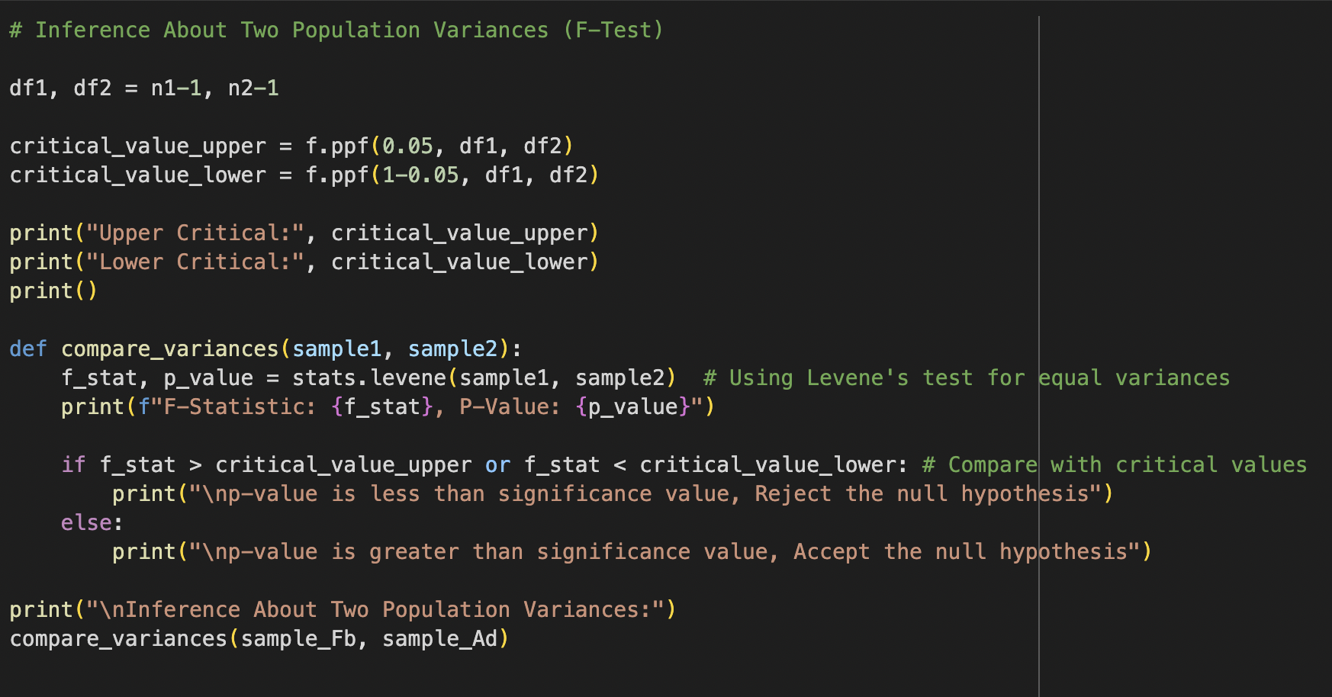
Inference on Population Variances using F test
The analysis using the F-Test indicates a significant difference between the variances of Facebook and AdWords conversion rates.
The test yielded an F-Statistic of 7.385 and a p-value of 0.0078, which is below the significance level (α=0.05). This leads us to reject the null hypothesis and conclude that the variances of the two populations are significantly different.

Slide 32
Inference on Population Variances using Chi-Square test
Objective: To test whether the variances of Facebook and AdWords conversion rates are equal.
Chi-Square Statistic: Evaluates a single population’s variance against a theoretical or expected value.
χ² = (n-1)*s²/σ²
Hypothesis:
Null Hypothesis (H0): The variance of a population matches the expected variance.
H0: Observed frequencies = Expected frequencies
Alternate Hypothesis (H1): The variance does not match the expected variance.
H1: Observed frequencies ≠ Expected frequencies

Slide 33
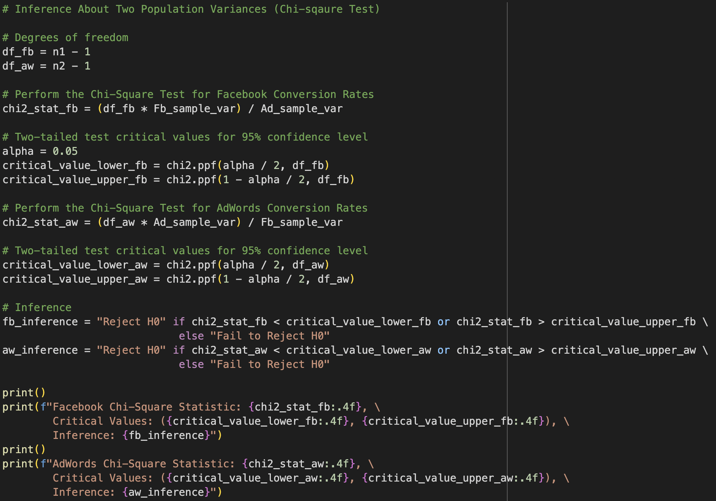
Inference on Population Variances using Chi-Square test
For Facebook, the Chi-Square statistic is 163.7113, which falls outside the critical range (31.5549, 70.2224), leading to the rejection of the null hypothesis (Ho).
Similarly, for AdWords, the Chi-Square statistic is 14.6661, which also falls outside the critical range, resulting in the rejection of Ho . These results suggest there is not enough evidence to assume that the variances of the two populations (Facebook and AdWords conversion rates) are equal.

Slide 34
Conclusion
The mean conversion rates for Facebook and AdWords are significantly different, as shown by both the T-test and Z-test.
The variances are also significantly different, indicating varying levels of consistency between the platforms.

Slide 35
Thank You

Slide 36
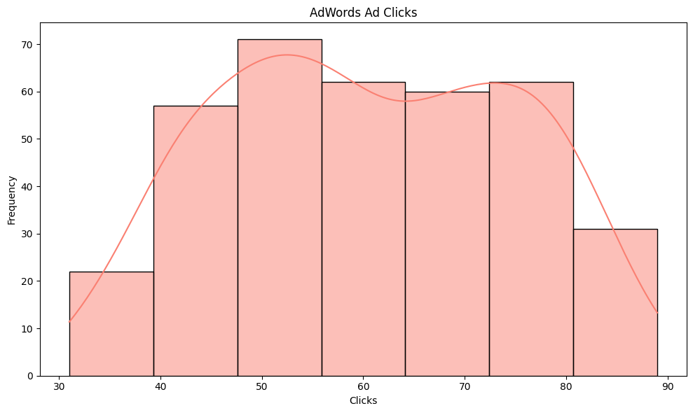
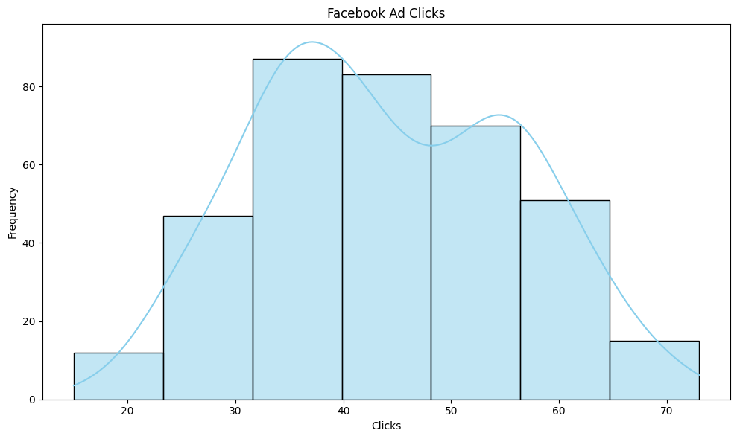
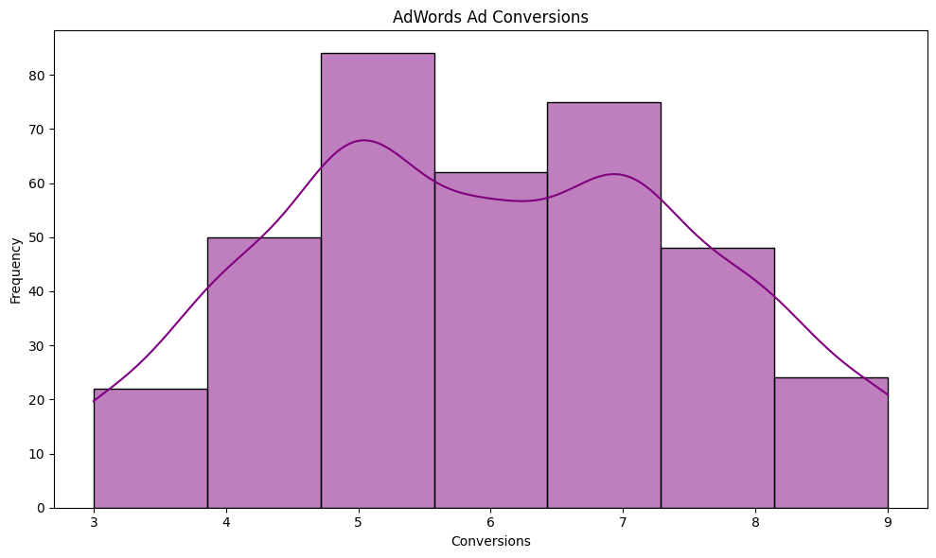
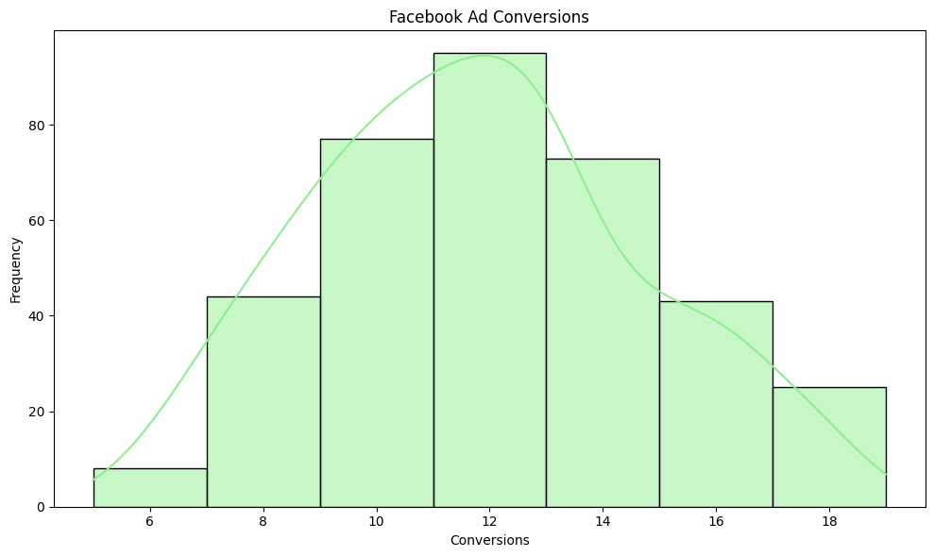
Histogram

